Slide 1

Project Title -Netflix Dataset Analysis
- Tejas Krushna Rawool
STU66fd636f0b64b1727882095

Slide 2

PROBLEM STATEMENT
Netflix is a prominent global streaming platform, but faces growing competition from services like Amazon Prime, Disney+, and other regional providers.
To stay competitive, Netflix must strategically analyze its content catalog to identify strengths, gaps, and opportunities . Problem Statement: 'Content Trends Analysis for Strategic Recommendations’.
Aim: To uncover how Netflix’s content distribution (Movies vs. TV Shows, genres, and country contributions) has evolved, enabling the identification of key trends and audience preferences.

Slide 3
Project Description
Netflix is a leading global streaming platform that is constantly expanding its content library with both original productions and licensed content. However, it faces increasing competition from other platforms like Amazon Prime, Disney+, and various regional providers.
The project, titled 'Content Trends Analysis for Strategic Recommendations,' aims to analyze Netflix's content catalog to identify strengths, weaknesses, and opportunities.
The primary goals are to : Uncover how the distribution of content (Movies vs. TV Shows, genres, and country contributions) has changed over the years . Identify key genres and audience preferences . Provide strategic insights to guide global content expansion.

Slide 4

WHO ARE THE END USERS?
Netflix Content Strategy Team – to identify content trends and plan future productions.
Data Analysts & Business Intelligence Teams – to make data-driven decisions on content acquisition.
Marketing Teams – to understand audience preferences and target promotions accordingly.
Investors and Stakeholders – to evaluate Netflix’s global growth and content diversification.
Academicians & Researchers – to study streaming trends and data visualization techniques.

Slide 5

Technology Used
- Python (Pandas, Matplotlib, Seaborn)
- Jupyter Notebook
- Data Visualization Libraries
- Microsoft PowerPoint for Reporting

Slide 6
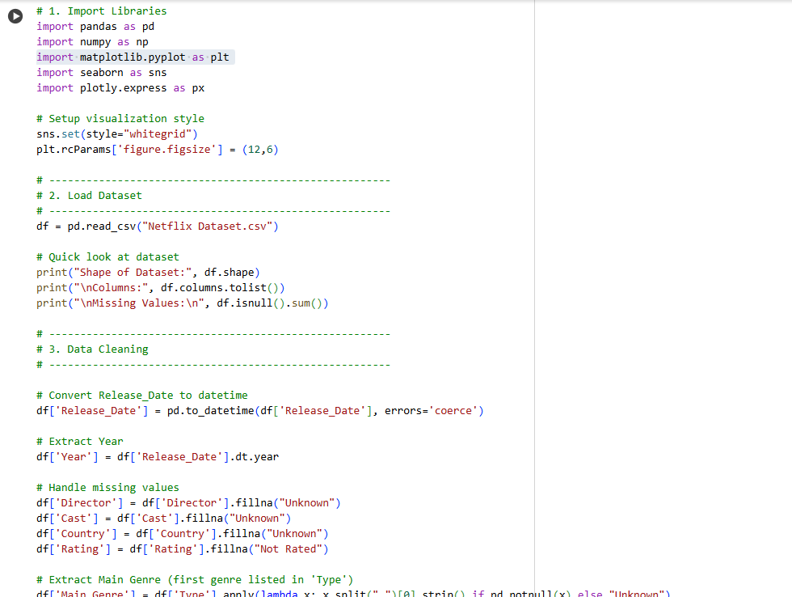
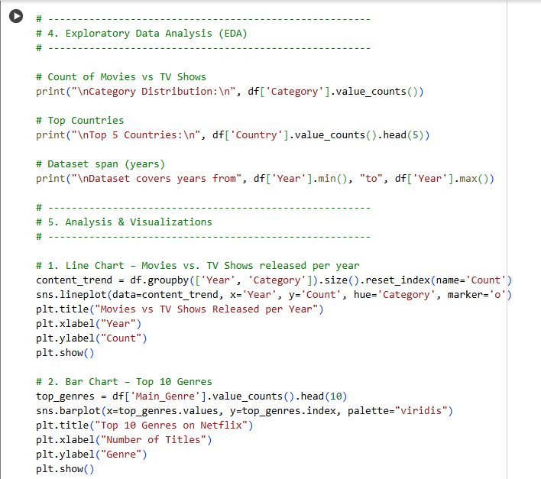
CODE

Slide 7
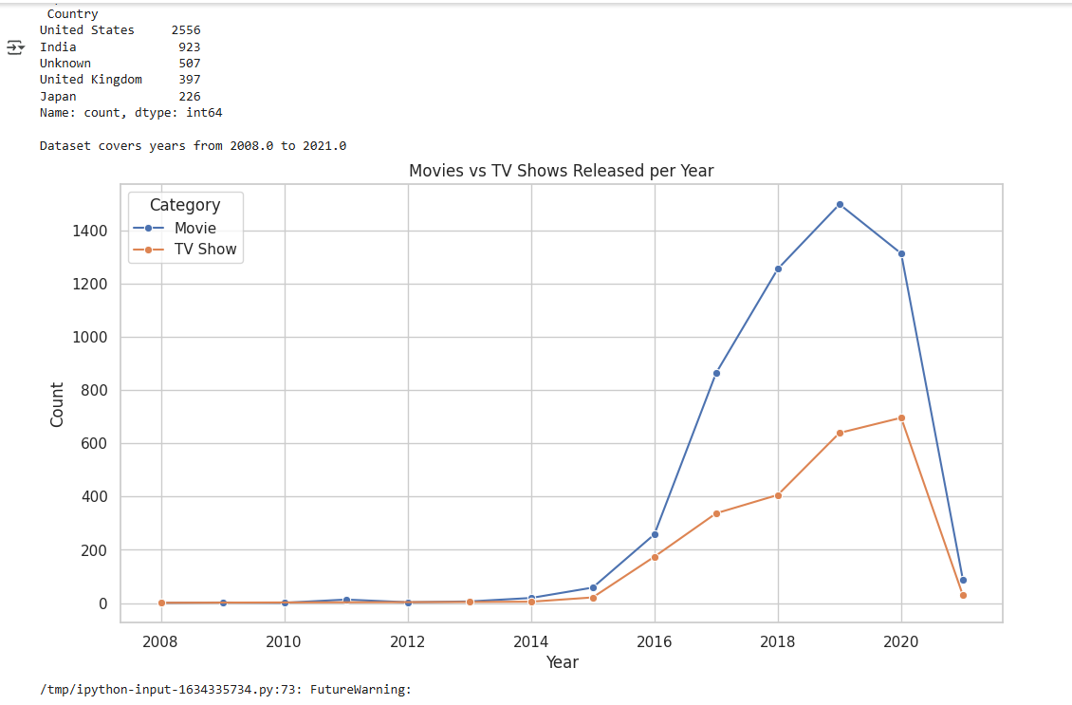
RESULTS1

Slide 8
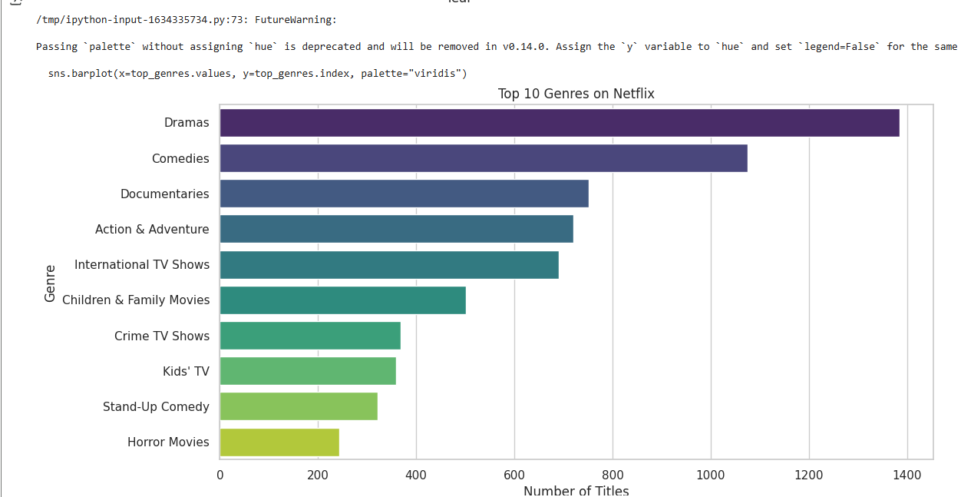
RESULTS2

Slide 9
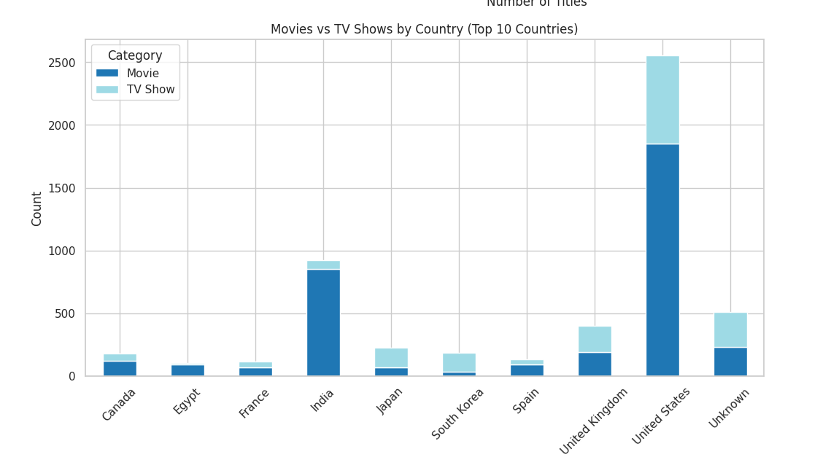
RESULTS3

Slide 10
GitHub repository
https://github.com/TejasRawool186/VOIS_AICTE_Oct2025_MajorProject_Tejas_Krushna_Rawool.git

Slide 11
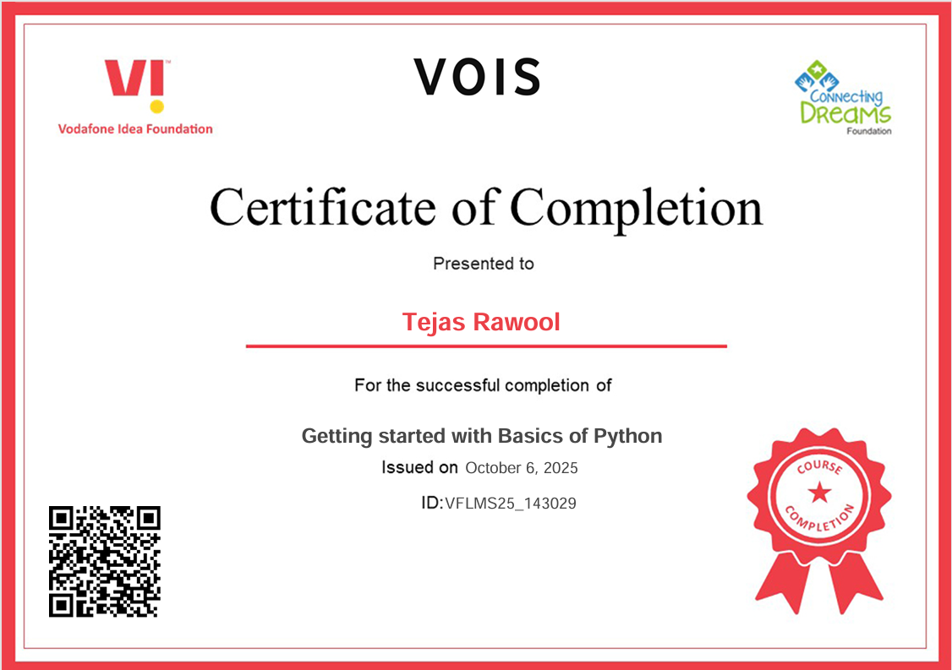
Getting started with Basics of Python Certificate
[Paste your Certificate Here]

Slide 12

Data Visualization Certificate

Slide 13
Thank you
.
.

